Slide 1
India’s Agricultural crop Production Analysis . Sri Amaraavathi college of Arts and science.
Faculty mentor ;
Mrs. P Rajalakshmi, Msc, M Phil, Assistant professor in mathematics.

Slide 2
Team members:
M. Kumari
M.Jeevitha
V.Roshini
S.Rubalakashmi

Slide 3
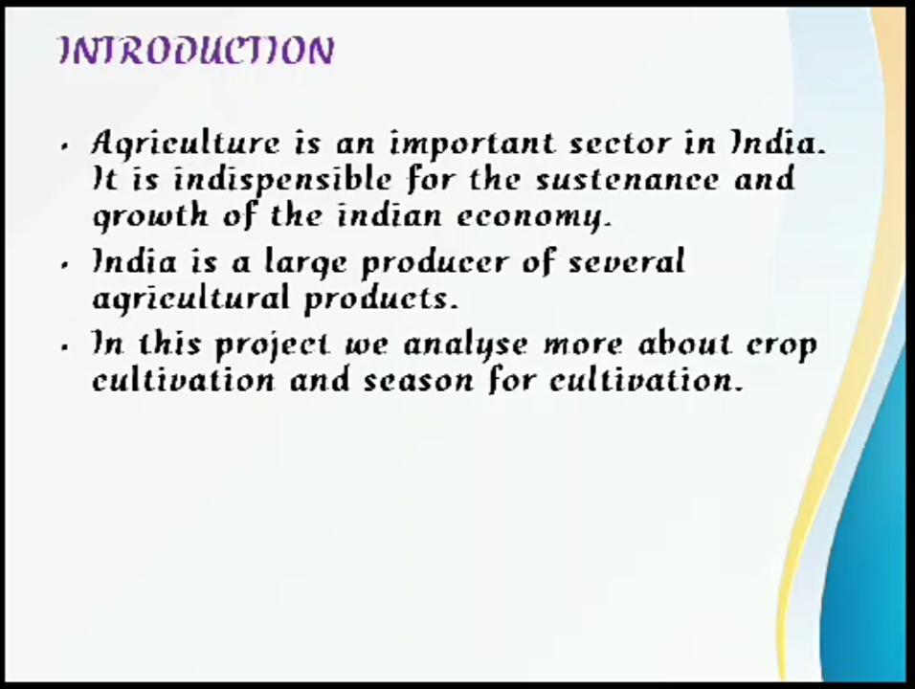

Slide 4
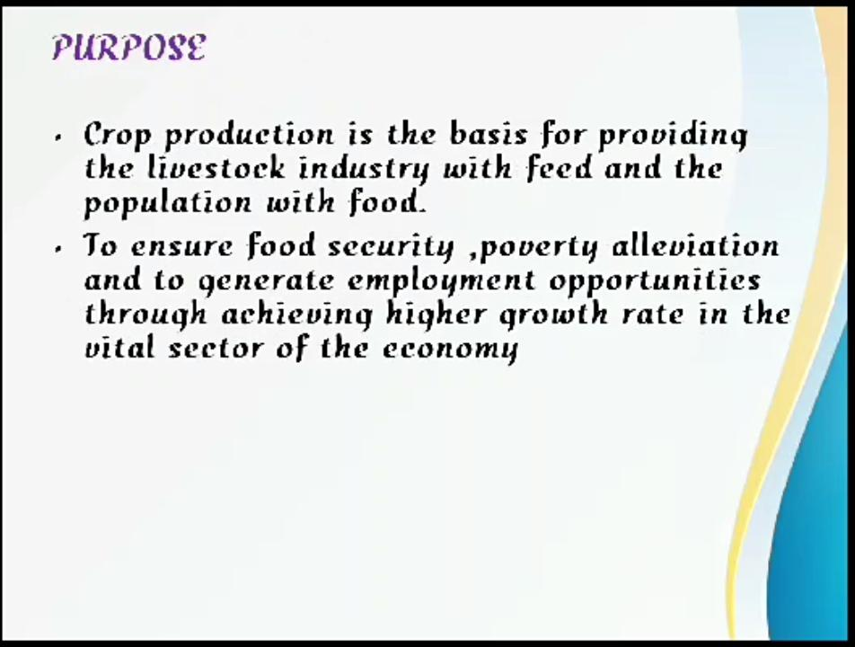

Slide 5
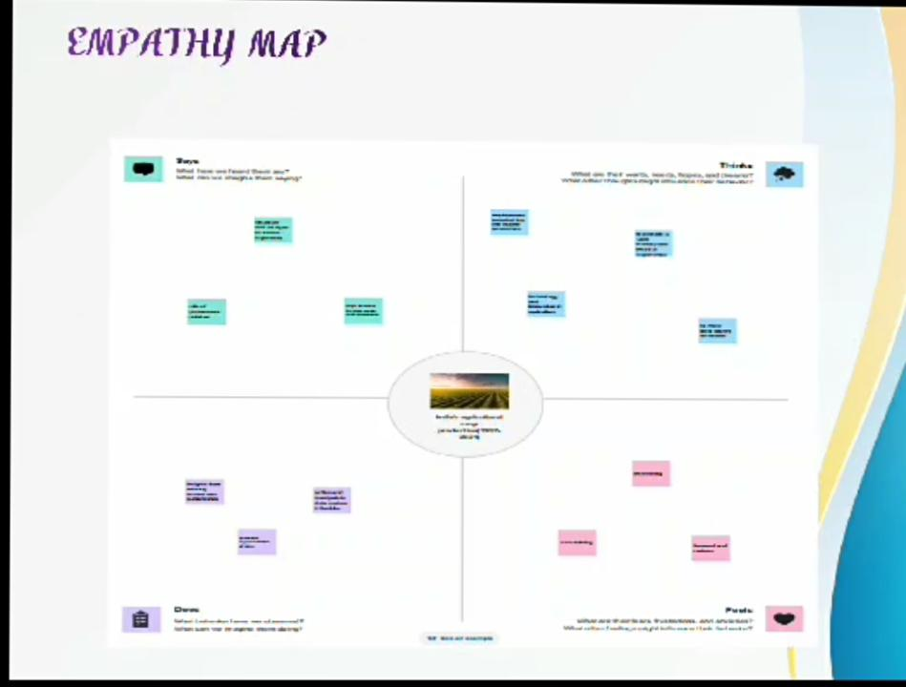

Slide 6
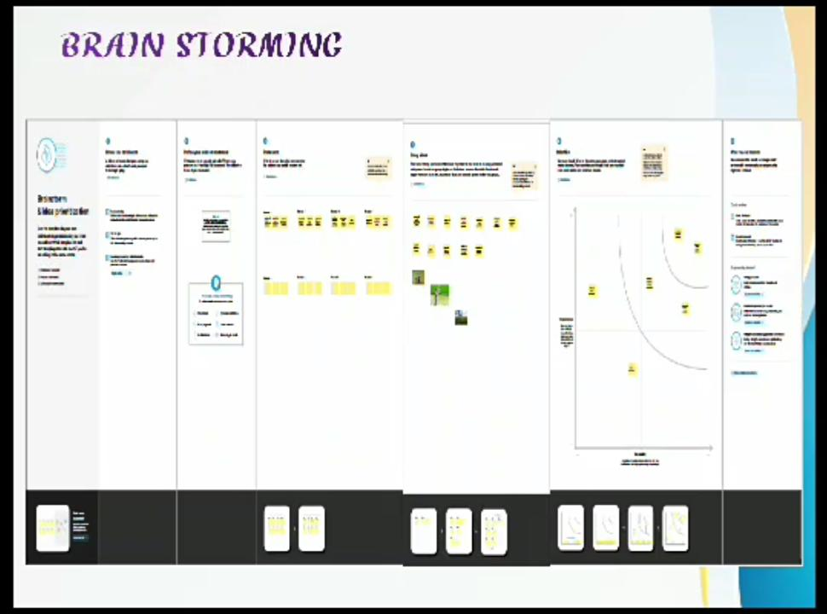

Slide 7
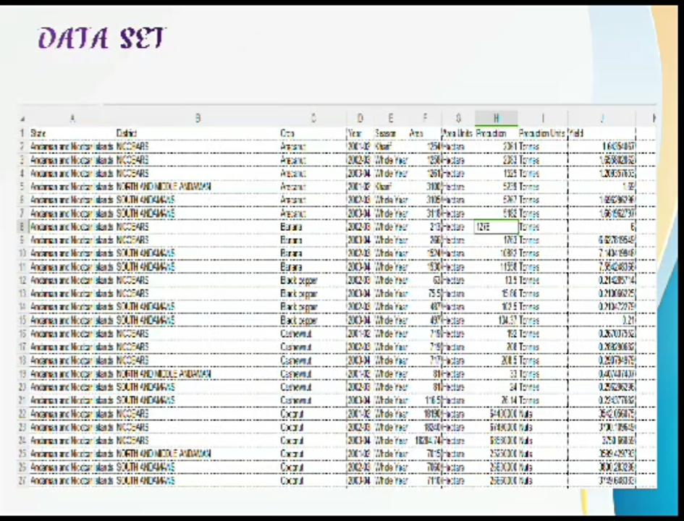

Slide 8
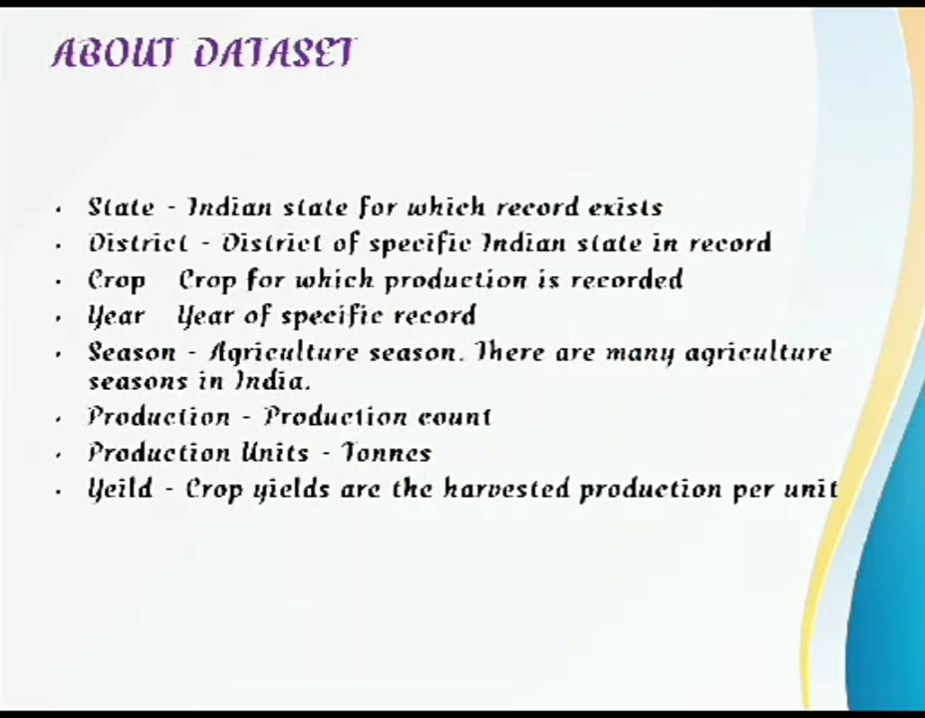

Slide 9
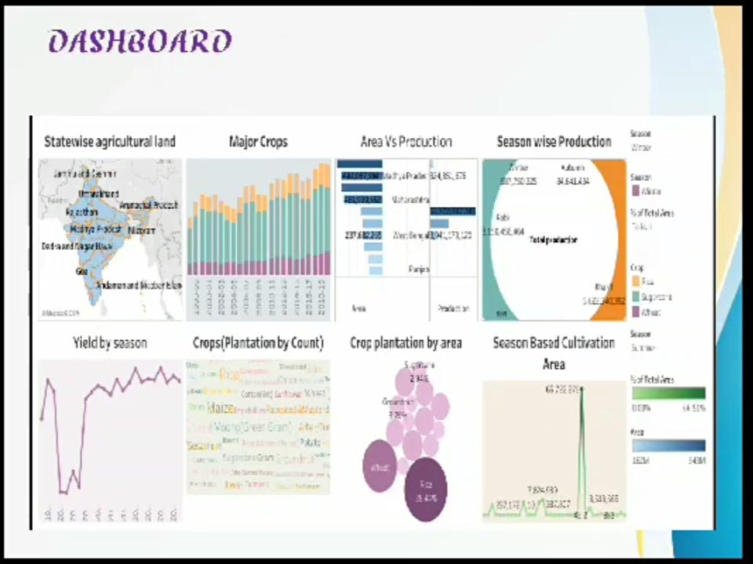

Slide 10
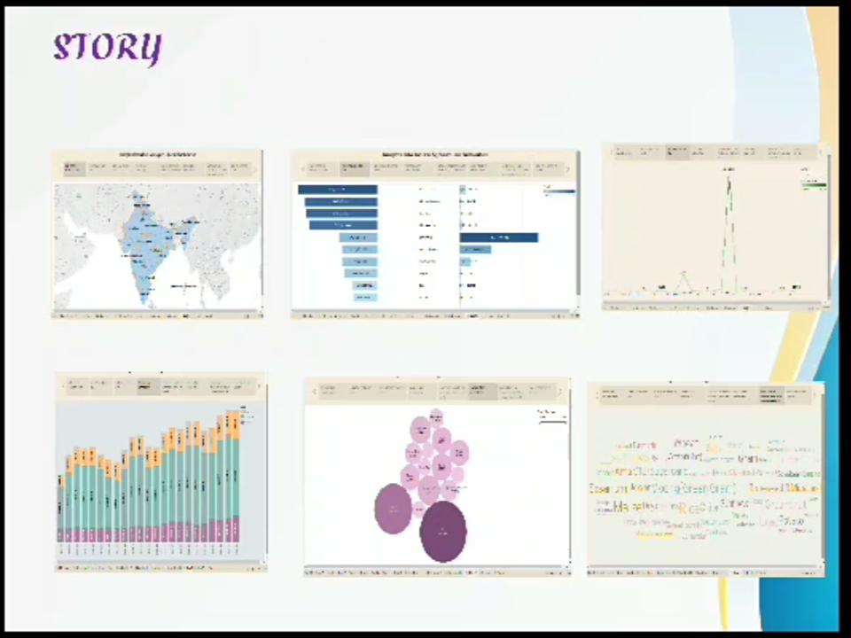

Slide 11
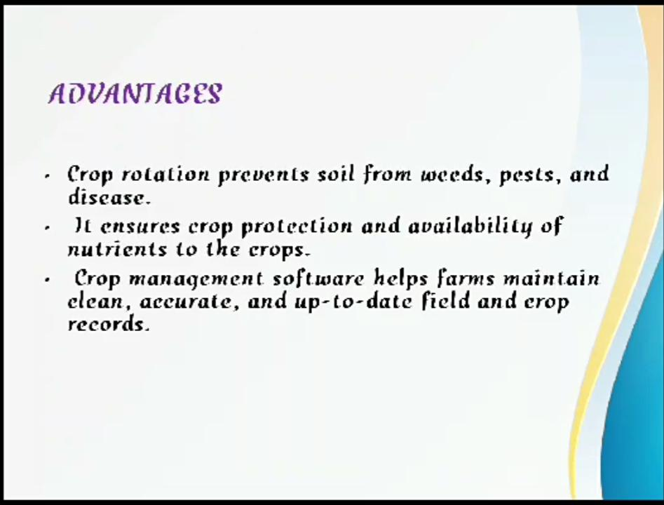

Slide 12
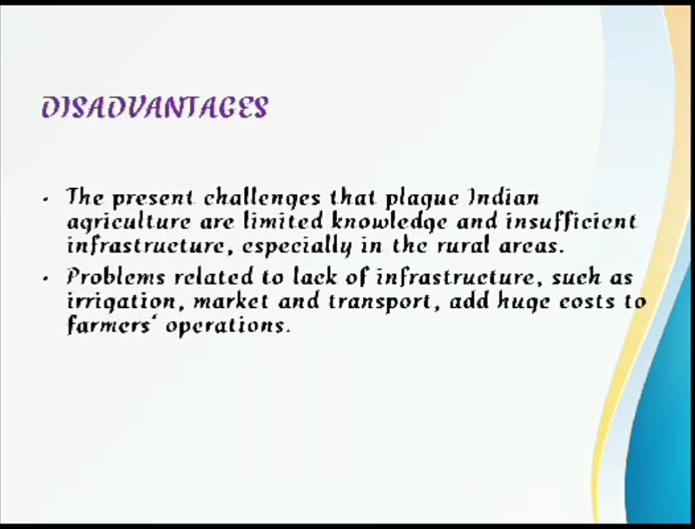

Slide 13
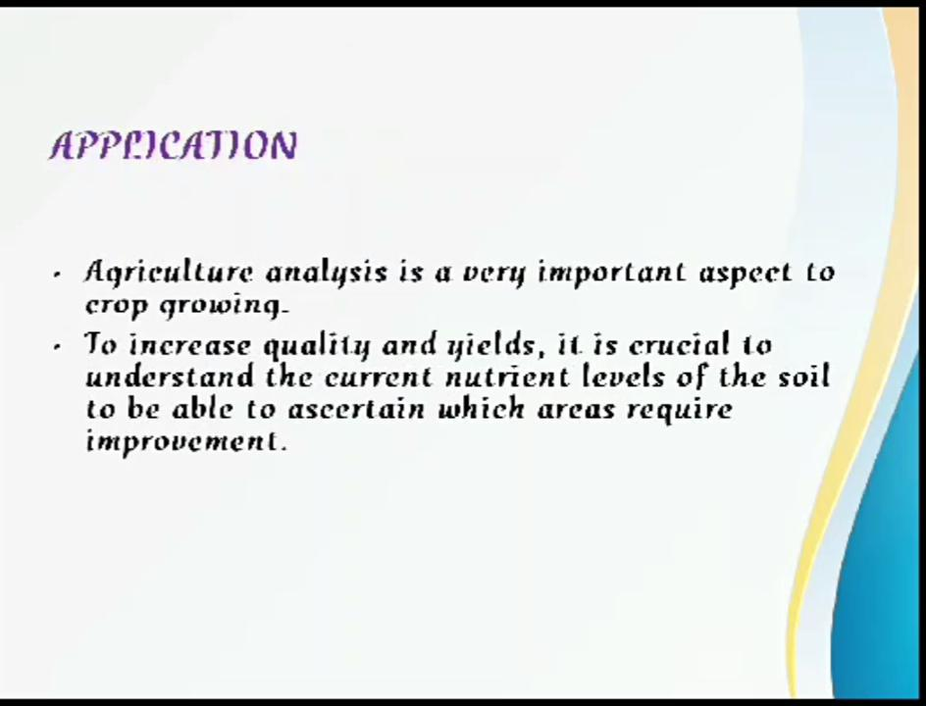

Slide 14
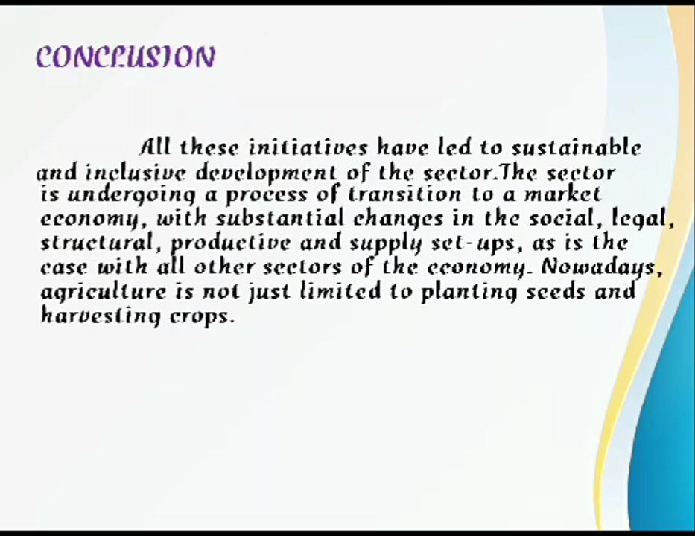

Slide 15
